Slide 1


Control Flow Integrity & Secure Data Flow
SE3331-1 (2022 Fall)
IPADS, Shanghai Jiao Tong University
https://www.sjtu.edu.cn
Notes:
Credits to Mike Freedman (COS 461) and others.

Slide 2
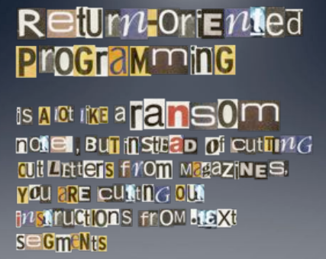

Slide 3
Defense
Hide the binary file
No way to get any gadget
ASLR to randomize the code position
Short for "Address Space Layout Randomization"
Harder to find gadgets
Canary to protect the stack
Try to detect stack overflow (e.g., overflow return address)
kernel中的userID为0；
将stack设计为从上到下的结构，本来是为了节省空间，并且充分利用高地址空间。
但是这种设计却使得buffer overflow攻击成为可能。

Slide 4
ASLR
Change the layout of memory space
Every time when a process is created
Question: how about create by fork?(fork的话不会随机，因为每次都和parent相同)
User-level as well as kernel-level

Slide 5

Canary(金丝雀)
Embed "canaries" in stack frames and verify their integrity prior to function return
Canary is just a random number(可以事先知道，但是要保证不会被泄露)
Check canary before return, alert if not equal
StackGuard implemented as a GCC patch
Program must be recompiled
Performance overhead: 8% for Apache
Stack
Return Addr
Canary

Slide 6
CFI: Control Flow Integrity

Slide 7
CFI: Control-Flow Integrity
Main idea: pre-determine control flow graph (CFG) of an application
Static analysis of source code
Static binary analysis ← CFI
Execution profiling
Explicit specification of security policy
Execution must follow the pre-determined control flow graph

Slide 8
CFI Motivation
Control flow
Anatomy of many software attacks
Notes:
Many software attacks consists in subverting(暗中破坏) the control-flow of a binary. Often the virus injects code of its own,. Then by a buffer overflow, it hijacks the program counter to execute the desired code, eventually reaching a point at which the system is compromised (e.g., a shell is executed).

Slide 9
CFI Idea
CFI主要目的是通过检查程序执行的执行流与源码的CFG是否相同来判断是否发生了控制流劫持攻击。
下面这张图的思路说的是，将一个根据源码生成的CFG“硬编码”到二进制可执行文件中去，之后在运行这个二进制文件的时候这个程序自身就可以检查执行的控制流是否正确。
+
=
Executable
Control-Flow Graph
Self-checking program
Notes:
The idea of CFI is very simple: embed a simple security policy within the executable itself, in the form of a control-flow graph. The executable itself will monitor its execution, and any attempt to deviate from the prescribed CFG will result in an error. Thus, if a virus attempts to step outside the prescribed CFG, it will shut down the program.

Slide 10
Branch Types
Direct Branches
Direct call
Direct jump
Indirect Branches
Return
Indirect call
Indirect jump
In Apache and its libraries
Types | In Binary | Run-time
Direct call | 16.8% | 14.5%
Direct jump | 74.3% | 0.8%
Return | 6.3% | 16.3%
Indirect call | 2.1% | 0.2%
Indirect jump | 0.5% | 68.3%
has 1 target: 94.7%
<= 2 targets: 99.3%
>10 targets: 0.1%
indirect通过汇编很难知道跳转的真正dst。

Slide 11
CFI: Binary Instrumentation
Use binary rewriting to instrument code with runtime checks
Inserted checks(在编译器中进行”插桩”) ensure that the execution always stays within the statically determined CFG
Whenever an instruction transfers control, destination must be valid according to the CFG
Goal: Secure even if the attacker has complete control over the thread's address space

Slide 12
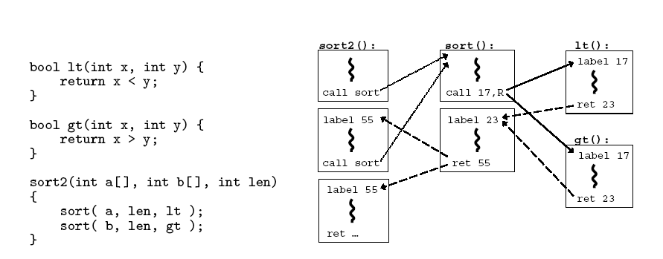
CFG Example
观察：调用sort的时候直接添加call sort，因为这是一个direct jump；
而调用lt和gt的时候需要call label 17，因为是一个非直接跳转(函数指针)，需要制定跳转的dst。注意每次call的时候应该跳转到函数的entry位置。
控制流记录方式：在每一个call后面添加一个ret_label。同时每一个call也应该有一个label。
图中调用了2次，sort但是实际上这两次的call和retlabel完全相同，可能发生只调用一次sort的攻击。同时，对于两个函数指针的指针也存在类似的问题。

Slide 13
CFI: Control Flow Enforcement
For each control transfer, determine statically its possible destination(s)
Insert a unique bit pattern at every destination
Two destinations are equivalent if CFG contains edges to each from the same source
This is imprecise (why?)(虽然都可达，但是中间路径可能不同)
Use same bit pattern for equivalent destinations

Slide 14
CFI: Control Flow Enforcement
Insert binary code that at runtime will check whether the bit pattern of the target instruction matches the pattern of possible destinations

Slide 15
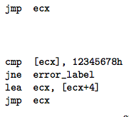
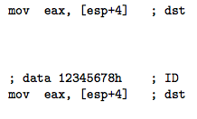
CFI: Example of Instrumentation
.data区域的data是不可执行的，但是内嵌在代码段中的data是可以被执行的，因为是否可执行是以PAGE为单位的。
Original
Patched
所加的patch的作用是检查要跳转的位置是否与CFG中记录的终点一样。即进行runtime的CFI保护。但是这样仍然存在问题，因为并不能保证所有代码段都执行这样的patch，若有的没有执行这个patch，那么在运行到data 12345678h是就会报错。

Slide 16
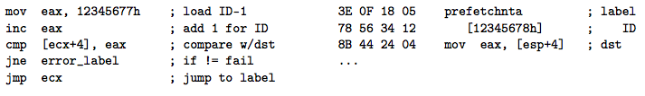
CFI: Example of Instrumentation
使用prefetchnta解决了前面提到的patch引起的不兼容问题。但是另一个问题是，这样做的话，即使是一个没有进行patch的攻击程序也可以进行CF的修改了，那么就相当于没有进行CFI检查。所以这里为了兼容性牺牲了一定的安全性。
Prefetchnta: prefetch memory to cache. Become a nop if not available.

Slide 17
CFI: Preventing Circumvention
Unique IDs
Bit patterns chosen as destination IDs must not appear anywhere else in the code memory except ID checks
Non-writable code
Program should not modify code memory at runtime
What about run-time code generation and self-modification?
Non-executable data
Program should not execute data as if it were code
Enforcement: hardware support + prohibit system calls that change protection state + verification at load-time

Slide 18
Improving CFI Precision
Suppose a call from A goes to C, and a call from B goes to either C, or D (when can this happen?)
CFI will use the same tag for C and D, but this allows an "invalid" call from A to D
Possible solution: duplicate code or inline
Possible solution: multiple tags

Slide 19
Improving CFI Precision
Function F is called first from A, then from B; what's a valid destination for its return?
CFI will use the same tag for both call sites, but this allows F to return to B after being called from A
Solution: shadow call stack

Slide 20
Shadow Stack
A shadow stack is a second stack for the program
Used exclusively for control transfer operations
Is separate from the data stack
Can be enabled for operation individually in user mode or supervisor mode
call stack作用是用于在同一个函数被不同的函数调用的时候确定最终的返回地址。对于内存中的栈，其即可能存储一个变量，也可能存储一些ret addr。而对于call stack，只会在要向内存栈中push一个ret addr的时候，同时向call stack里面push一个ret addr。所以在最终返回的时候，将call 和内存stack同时pop，若两个ret label对应的addr相同才跳转，否则不跳转。

Slide 21
Shadow Stack Mode
CALL instruction
Pushes the return address on both the data and shadow stack
RET instruction
Pops the return address from both stacks and compares them
If the return addresses from the two stacks do not match, the processor signals a control protection exception (#CP)
Note that the shadow stack only holds the return addresses and not parameters passed to the call instruction

Slide 22
Indirect Branch Tracking
New instruction: ENDBRANCH（在callee函数头部）
Mark valid indirect call/jmp targets in the program
Becomes a NOP on legacy processor
On processors that support CET(control-flow enforcement technology) the ENDBRANCH is still a NOP and is primarily used as a marker instruction by the in-order part of the processor pipeline to detect control flow violations

Slide 23
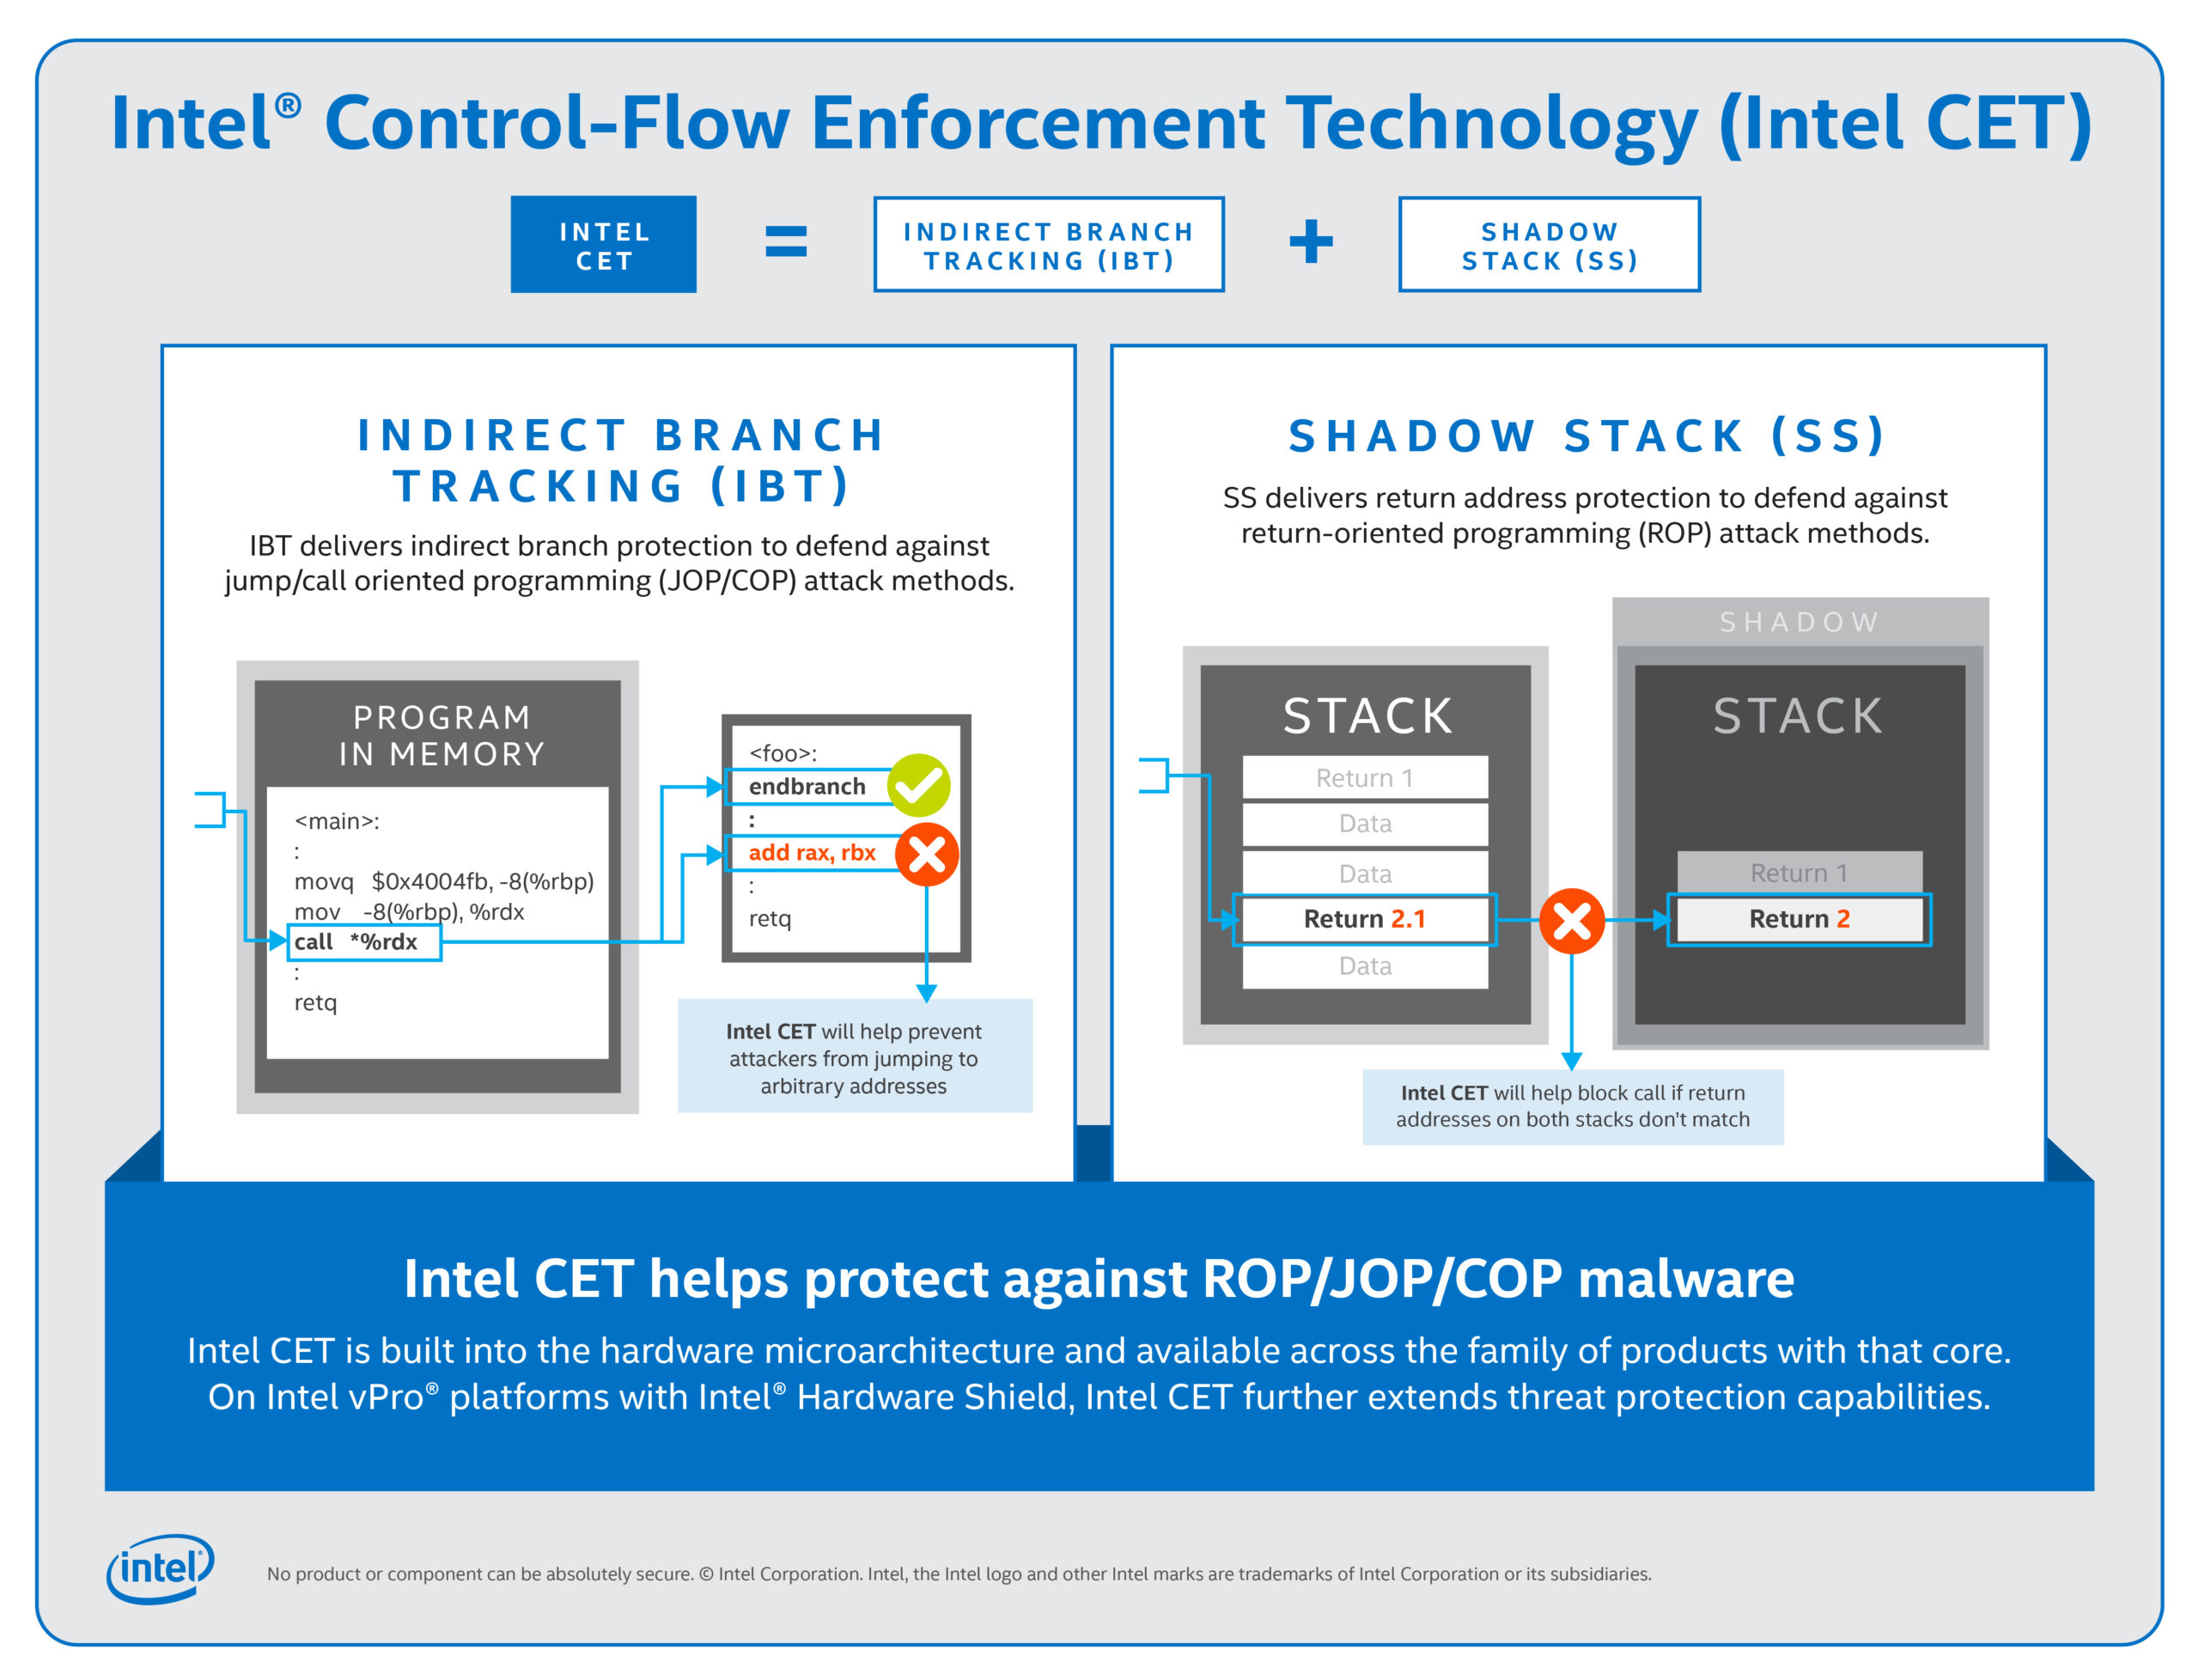
Intel CET Answers Call to Protect Against Common Malware Threats | Intel Newsroom | Deutschland

Slide 24
WAIT_FOR_ENDBRANCH State
The CPU implements a state machine that tracks indirect jmp and call
When one of these instructions is seen, the state machine moves from IDLE to WAIT_FOR_ENDBRANCH state
In WAIT_FOR_ENDBRANCH state the next instruction in the program stream must be an ENDBRANCH
If an ENDBRANCH is not seen the processor causes a control protection fault else the state machine moves back to IDLE state

Slide 25
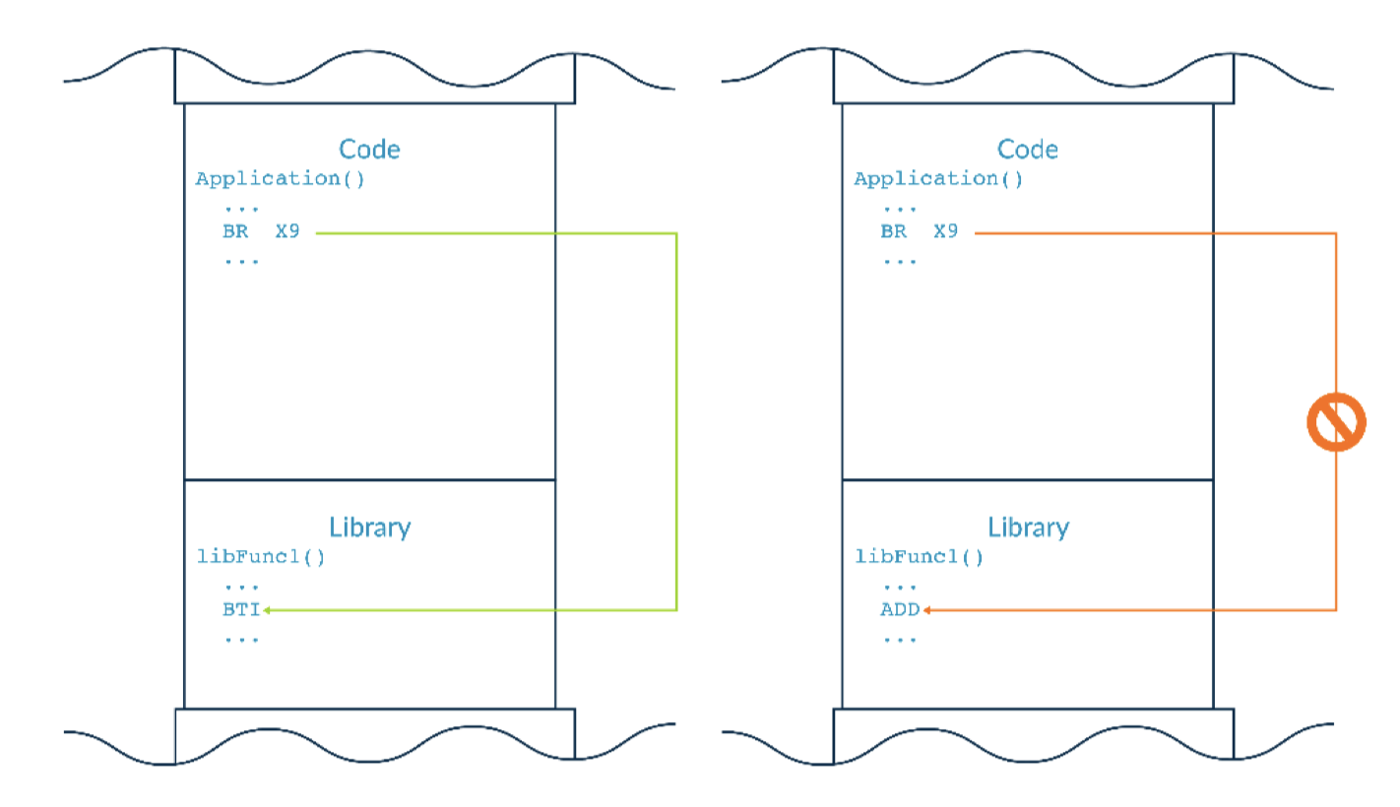
ARM BTI (Branch Target Instructions)

Slide 26
CFI: Security Guarantees
Effective against attacks based on illegitimate control-flow transfer
Stack-based buffer overflow, return-to-libc exploits, pointer subterfuge
Does not protect against attacks that do not violate the program's original CFG
Incorrect arguments to system calls
Substitution of file names
Other data-only attacks

Slide 27
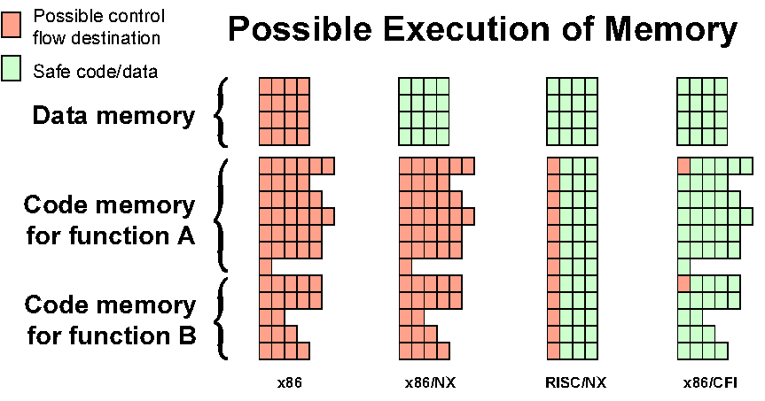
Possible Execution of Memory
[Erlingsson]

Slide 28
Data Flow Protection

Slide 29
Two Usages of Data Flow Tracking
Usage-1: protect critical data
E.g., track data to ensure none is leaked
Usage-2: defend against suspicious input data
E.g., one input data cannot flow to return address!

Slide 30
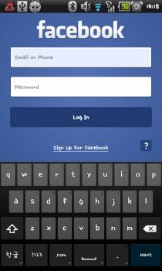
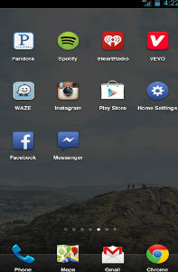
Ways an Attacker Can Steal Your Secrets
KeyLogger: install a KeyLogger/TouchLogger on the phone
Phishing: install a malware and lure the user to enter password
Malicious app
in background,
waiting for the
Facebook app
to launch
Once Facebook app starts, the malicious app will get active and make itself cover the real UI
Bianchi, Antonio, et al. "What the App is That? Deception and Countermeasures in the Android User Interface.", S&P 2015.
Notes:
Or he can install a malware to lure the user to enter password. A typicall malware will run in background...

Slide 31

Ways an Attacker Can Steal Your Secrets
KeyLogger: install a KeyLogger/TouchLogger on the phone
Phishing: install a malware and lure the user to enter password
MemScan: use rootkit and scan the memory for any plaintext
010100101010101000101010101010101010101010101010010101010101010010101010101010101001010011010101010101010101010001001000000101010010010010
The Samsung memory mapping bug: http://forum.xda-developers.com/showthread.php?t=2048511
Notes:
Or, he can just use rootkit and scan the memory for any plaintext

Slide 32
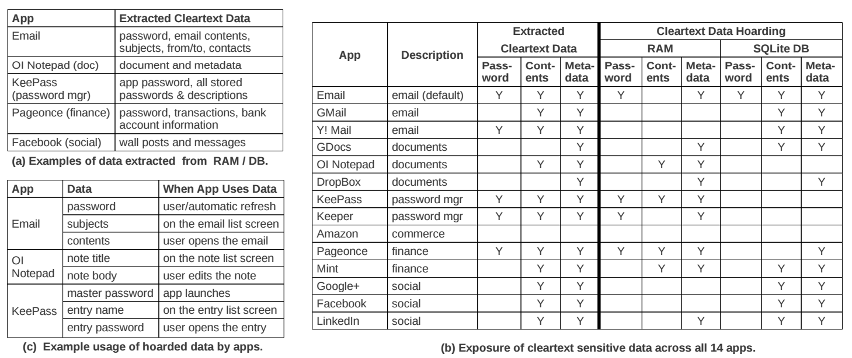
The "Data Residue" Problem
The plaintext of confidential data may exist in memory on a mobile device for a long time
应用对关键数据的保护不够
引CleanOS的数据
Android's default Email app:
has plaintext of password in RAM 10 minutes after login
Tang, Yang, et al. "CleanOS: Limiting Mobile Data Exposure with Idle Eviction." OSDI. 2012.
Notes:
This attack is simple but effective since the memory does contain many secrets. Here is a table from cleanOS, OSDI'12 paper.
It shows that many popular applications will leave residue of critical data in memory for a long time. For example,
the android's default email app,

Slide 33
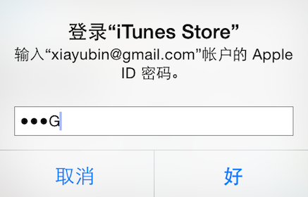
Ways an Attacker Can Steal Your Secrets
KeyLogger: install a KeyLogger/TouchLogger on the phone
Phishing: install a malware and lure the user to enter password
MemScan: use rootkit and scan the memory for any plaintext
ScreenCapture: get information directly from the screen
Jang, Yeongjin, et al. "A11y Attacks: Exploiting Accessibility in Operating Systems." CCS, 2014.
Notes:
The attacker might also steal your password from screen. On iOS system, once you enter a password, the last character will be displayed for a second. If the attacker can access framebuffer or capture the screen, he can get your password

Slide 34
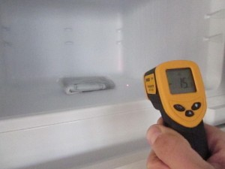
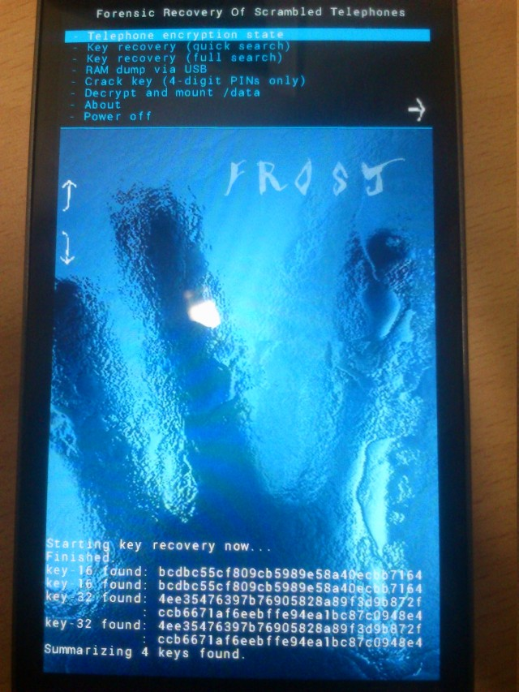
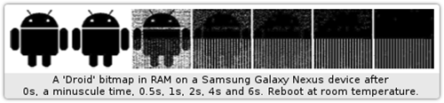
Ways an Attacker Can Steal Your Secrets
KeyLogger: install a KeyLogger/TouchLogger on the phone
Phishing: install a malware and lure the user to enter password
MemScan: using rootkit and scan memory for any plaintext
ScreenCapture: get information directly from the screen
Cold-boot: physically attack that can scan memory to get any plaintext
Müller, Tilo, and Michael Spreitzenbarth. "Frost." Applied Cryptography and Network Security. Springer Berlin Heidelberg, 2013.
Notes:
Cold boot attack is also possible on the mobile device, which just scan the memory to get an plaintext.

Slide 35
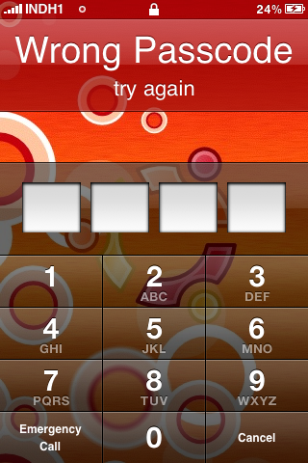
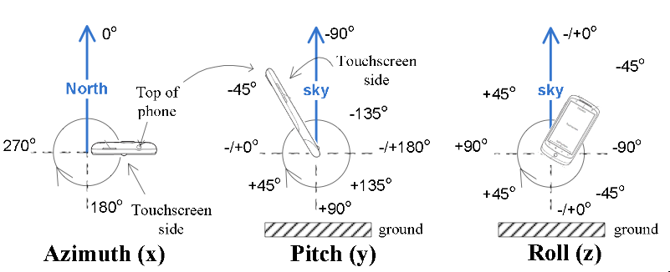
Ways an Attacker Can Steal Your Secrets
KeyLogger: install a KeyLogger/TouchLogger on the phone
Phishing: install a malware and lure the user to enter password
MemScan: using rootkit and scan memory for any plaintext
ScreenCapture: get information directly from the screen
Coldboot: physically scan the memory to get any plaintext
Side-Channel: infer PIN code through motion-detector
Cai, Liang, and Hao Chen. "TouchLogger: Inferring Keystrokes on Touch Screen from Smartphone motion." HotSec. 2011.
Notes:
A even more sophistic attack is to use the motion-detector to guess the user's PIN code, just by learning the relationship between the PIN and phone's inclination when pressing the screen.

Slide 36
Taint Tracking
Data Protection

Slide 37
Data Lifetime
The lifetime of sensitive data should be minimized
The longer data remains in memory the greater its chances of being leaked to disk
Swapping, hibernation, VM suspending, core dump, etc.
That's what we called "data exposure"

Slide 38
Taint(污点)ing: Data Flow Tracking
Apply access policy along the data flow
E.g., a password cannot be sent to Internet
E.g., credit card number cannot be sent to other apps
E.g., untrusted data cannot be executed
taint tracking能成立的前提是认为，一个critical data在lifetime中，是一直处于暴露状态的。但是如果attacker通过加密，打包等方式进行了额外处理可能就会失效。这就需要compiler在处理数据的时候进行额外的处理。

Slide 39
Dynamic Taint Analysis
i = get_input();
two = 2;
if(i%2 == 0){
j = i+two;
l = j;
} else {
k = two*two;
l = k;
}
jmp l;
Example sourced from CMU ECE
Source
Will show the basic approach of dynamic taint analysis
Two concrete executions will be presented
Goal: evaluate whether control can be hijacked by [malicious] user input

Slide 40
Dynamic Taint Analysis
i = get_input();
two = 2;
if(i%2 == 0){
j = i+two;
l = j;
} else {
k = two*two;
l = k;
}
jmp l;
Variable | Value | Taint Status

Slide 41
Dynamic Taint Analysis
i = get_input();
two = 2;
if(i%2 == 0){
j = i+two;
l = j;
} else {
k = two*two;
l = k;
}
jmp l;
Variable | Value | Taint Status
i | 6 | true

Slide 42
Dynamic Taint Analysis
i = get_input();
two = 2;
if(i%2 == 0){
j = i+two;
l = j;
} else {
k = two*two;
l = k;
}
jmp l;
Variable | Value | Taint Status
i | 6 | true
two | 2 | false

Slide 43
Dynamic Taint Analysis
i = get_input();
two = 2;
if(i%2 == 0){
j = i+two;
l = j;
} else {
k = two*two;
l = k;
}
jmp l;
Variable | Value | Taint Status
i | 6 | true
two | 2 | false
j | 8 | true

Slide 44
Dynamic Taint Analysis
i = get_input();
two = 2;
if(i%2 == 0){
j = i+two;
l = j;
} else {
k = two*two;
l = k;
}
jmp l;
Variable | Value | Taint Status
i | 6 | true
two | 2 | false
j | 8 | true
l | 8 | true
Notes:
In this case, the taint analysis would show that an attack is possible. Notice, however, that we don't know exactly how variable L is tainted by variable I as we do in a fully symbolic execution—we only know that the two variables are related. However, computing a fully symbolic execution is often intractable, thus giving dynamic taint analysis some merits as a higher-performance technique (in terms of computational efficiency).

Slide 45
Dynamic Taint Analysis
i = get_input();
two = 2;
if(i%2 == 0){
j = i+two;
l = j;
} else {
k = two*two;
l = k;
}
jmp l;
Variable | Value | Taint Status

Slide 46
Dynamic Taint Analysis
i = get_input();
two = 2;
if(i%2 == 0){
j = i+two;
l = j;
} else {
k = two*two;
l = k;
}
jmp l;
Variable | Value | Taint Status
i | 7 | true

Slide 47
Dynamic Taint Analysis
i = get_input();
two = 2;
if(i%2 == 0){
j = i+two;
l = j;
} else {
k = two*two;
l = k;
}
jmp l;
Variable | Value | Taint Status
i | 7 | true
two | 2 | false

Slide 48
Dynamic Taint Analysis
i = get_input();
two = 2;
if(i%2 == 0){
j = i+two;
l = j;
} else {
k = two*two;
l = k;
}
jmp l;
Variable | Value | Taint Status
i | 7 | true
two | 2 | false
k | 4 | false

Slide 49
Dynamic Taint Analysis
i = get_input();
two = 2;
if(i%2 == 0){
j = i+two;
l = j;
} else {
k = two*two;
l = k;
}
jmp l;
Variable | Value | Taint Status
i | 7 | true
two | 2 | false
k | 4 | false
l | 4 | false
Notes:
In this case, the taint analysis would show that an attack is not possible.

Slide 50
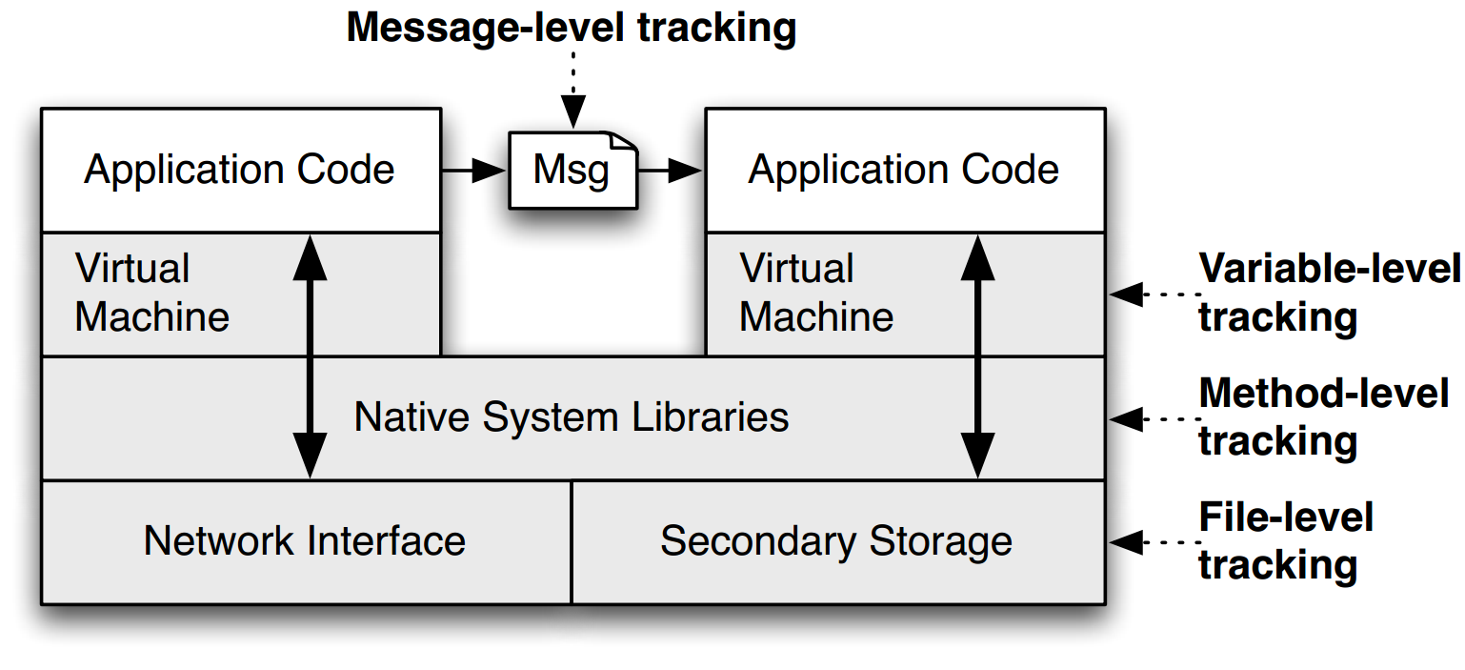
TaintDroid
Notes:
This is a figure from the conference paper describing TaintDroid. It shows where, at a high level, the various kinds of taint analysis are done. There are 4 "granularities" of taint analysis used in TaintDroid, including message-level, variable-level, method-level, and file-level.

Slide 51
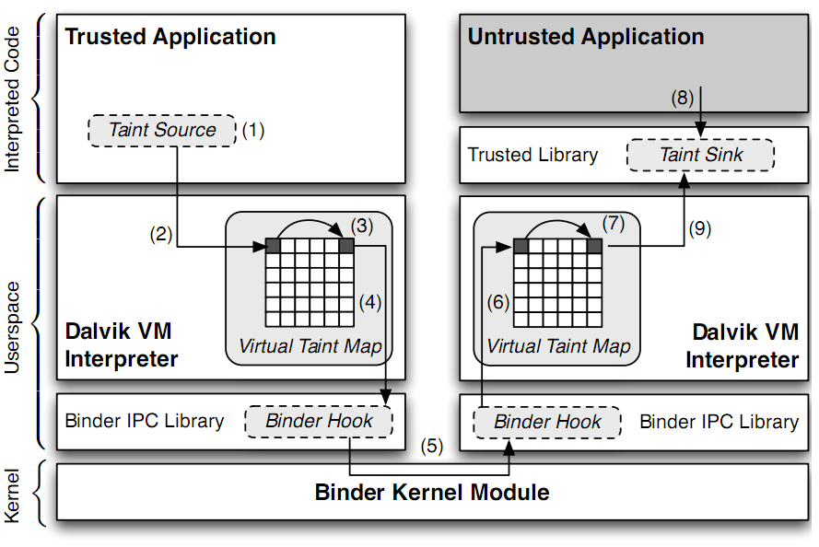
TaintDroid Data Flow
Notes:
Sensitive information is ﬁrst identiﬁed at a taint source, where a taint marking indicating the information type is assigned. Dynamic taint
analysis tracks how labeled data impacts other data in a way that might leak the original sensitive information.
Finally, the impacted data is identiﬁed before it leaves the system at a taint sink (usually the network interface).
possible false positive

Slide 52
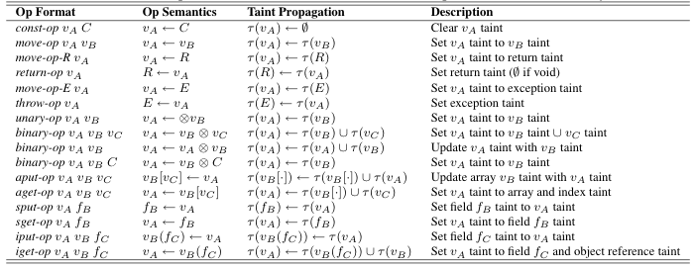
Taint Propagation

Slide 53

Defending Malicious Input

Slide 54
Two Usages of Data Flow Tracking
Usage-1: protect critical data
E.g., track data to ensure none is leaked
Usage-2: defend against suspicious(可疑的) input data
E.g., one input data cannot flow to return address!

Slide 55
How does a Hacker Search a Bug?
Step-0: Chose a library (open-source, of course)
Let's try ffmpeg, which is used in Chrome, VLC, Mplayer...
There are also rumors that YouTube uses it for conversion
Step-1: List the demuxers of ffmpeg
Step-2: Identify the input data
Step-3: Trace the input data

Slide 56
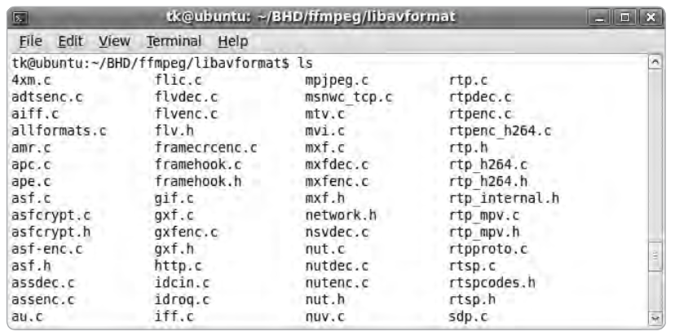
Step-1: List the Demuxers of FFmpeg

Slide 57
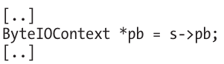
Step-2: Identify the Input Data
demuxername_read_header()
Most demuxers declare a function called it
Takes a parameter of type AVFormatContext
This function initializes a pointer:
Many different get_something() are used to extract pb data
E.g., get_le32(), get_buffer()
Conclusion: pb is a pointer to the input data of media files

Slide 58
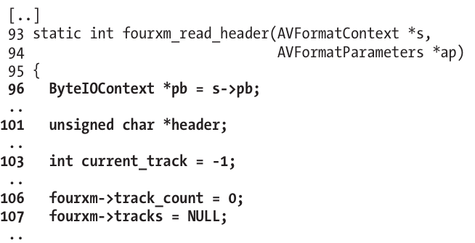
Step-3: Trace the Input Data
Start to read the first demuxer: libavformat/4xm.c(越少被使用的文件出现bug的可能性越大)

Slide 59
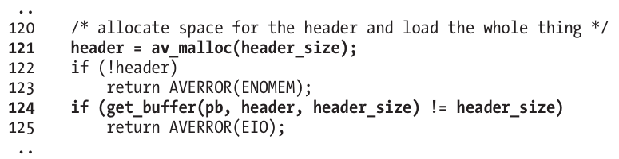
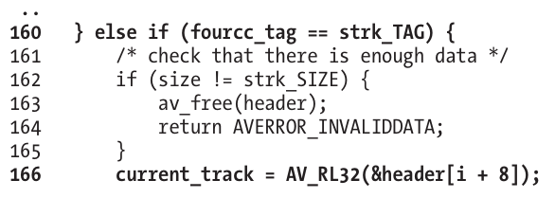
int
unsigned int

Slide 60
Step-3: Trace the Input Data
Supplying a value >= 0x80000000 for current_track causes a change in sign that results in current_track being interpreted as negative
The if statement in line 167 will always return FALSE
Thus, the buffer allocation in line 171 will never be reached

Slide 61
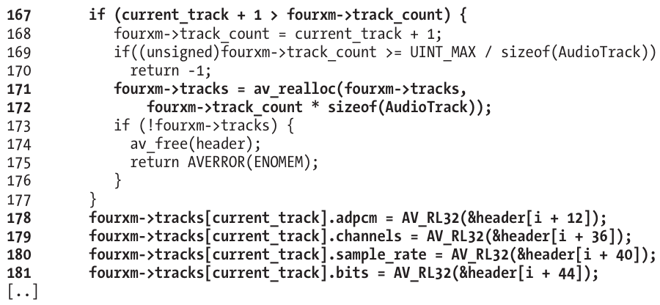
Step-3: Trace the Input Data
arbitrary memory writes arbitrary val

Slide 62
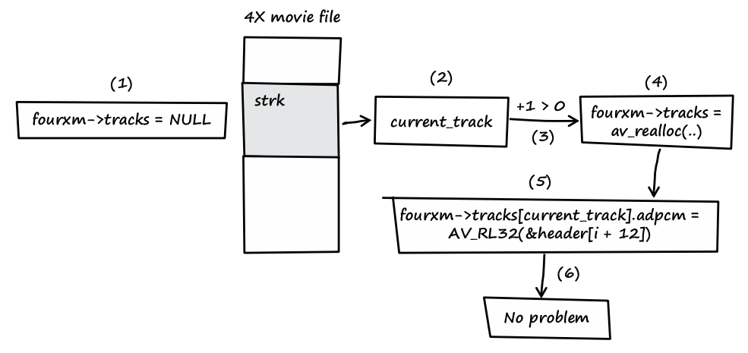
Step-3: Trace the Input Data
Notes:
fourxm->tracks is initialized with NULL (see line 107).
If the processed media file contains a strk chunk, the value of current_track is extracted from the user-controlled data of the chunk (see line 166).
If the value of current_track + 1 is greater than zero, a heap buffer is allocated.
The heap buffer pointed to by fourxm->tracks is allocated (see lines 171 and 172).
Data from the media file is copied into the heap buffer, while current_track is used as an array index into the buffer (see lines 178–181).
When this behavior occurs, there is no security problem.

Slide 63
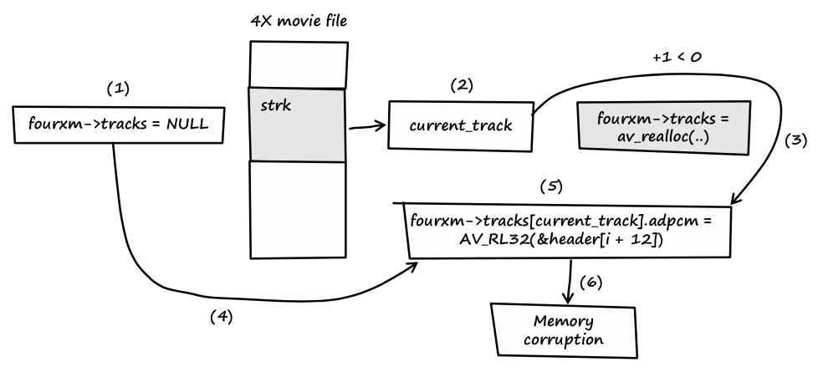
Step-3: Trace the Input Data
Notes:
fourxm->tracks is initialized with NULL (see line 107).
If the processed media file contains a strk chunk, the value of current_track is extracted from the user-controlled data of the chunk (see line 166).
If the value of current_track + 1 is less than zero, the heap buffer isn't allocated.
fourxm->tracks still points to memory address NULL.
The resulting NULL pointer is then dereferenced by the user- controlled value of current_track, and four 32-bit values of user- controlled data are assigned to the dereferenced locations (see lines 178–181).
Four user-controlled memory locations can be overwritten with four user-controlled data bytes each.

Slide 64
Question
How can we use taint tracking to find such bugs?

Slide 65
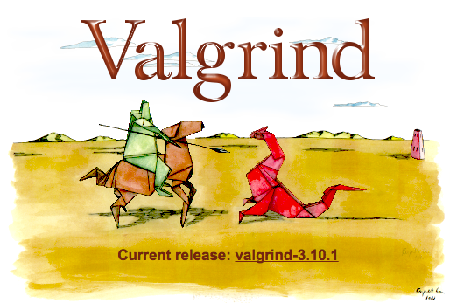
TaintCheck: Basic Ideas
Program execution normally derived from trusted sources, not attacker input
Mark all input data to the computer as "tainted" (e.g., network, stdin, etc.)
Monitor program execution and track how tainted data propagates (follow bytes, arithmetic operations, jump addresses, etc.)
Detect when tainted data is used in dangerous ways

Slide 66
Add Taint Checking code
TaintCheck first runs the code through an emulation environment (Valgrind) and adds instructions to monitor tainted memory
X86 instructions
UCode
Binary re-writer
Taint Check
X86 instructions
UCode
Dynamic taint analysis

Slide 67
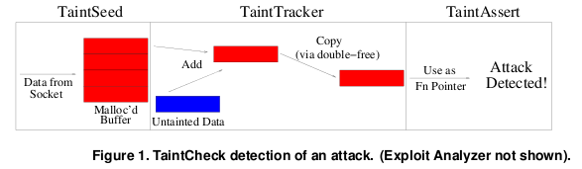
TaintCheck Detection Modules
TaintSeed: Mark untrusted data as tainted
TaintTracker: Track each instruction, determine if result is tainted
TaintAssert: Check is tainted data is used dangerously

Slide 68
Performance Evaluation – CPU Bound Process
Hardware: 2.00 GHz Pentium 4, 512 MB RAM, RedHat 8.0
Application: bzip2(15mb)
Normal runtime 8.2s
Valgrind nullgrind skin runtime: 25.6s (3.1x)
Memcheck runtime: 109s (13.3x)
TaintCheck runtime: 305s (37.2x)

Slide 69
Performance Overhead of Apache
A more representative case, network and I/O
Better performance

Slide 70
Secure Channel

Slide 71
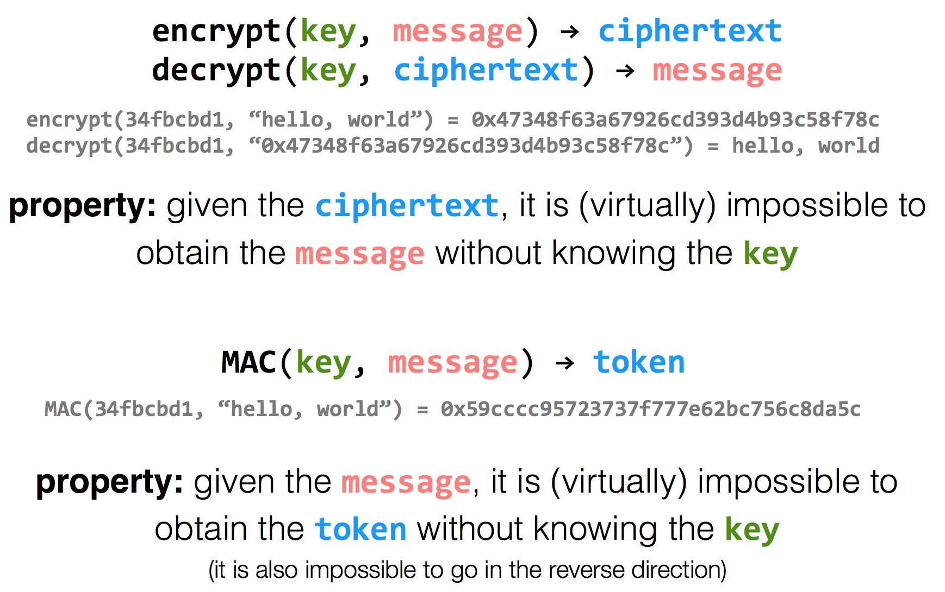
Encryption Properties

Slide 72
has k
has k
k=key
m=message
Alice
Bob
c = encrypt(k, m)
h = MAC(k, m)
c | h
m = decrypt(k, c)
MAC(k, m) == h ?

Slide 73
has k
has k
Alice
Eve
Bob
c = encrypt(k, m)
h = MAC(k, m)
c | h
m = decrypt(k, c)
MAC(k, m) == h ?
c | h
Problem: replay attacks (adversary could intercept a message, re-send it at a later time)
c | h

Slide 74
has k
has k
Alice
Bob
c = encrypt(k, m | seq)
h = MAC(k, m | seq)
c | h
m | seq = decrypt(k, c)
MAC(k, m | seq) == h ?

Slide 75
has k
has k
Alice
Eve
Bob
c = encrypt(k, m | seq)
h = MAC(k, m | seq)
c | h
m | seq = decrypt(k, c)
MAC(k, m | seq) == h ?
c | h
if reuse seq (e.g., date)
problem: reflection attacks (adversary could intercept a message, re-send it later in the opposite direction)
Notes:
But if receiver is also sending to the sender (i.e., if they're both sending), the receiver might use that sequence number. So adversary could replay in the other direction (a "reflection" attack) - Solution: Use different keys in each direction

Slide 76
has k_{a} & k_{b}
has k_{a} & k_{b}
Alice
Bob
c_{a} = encrypt(k_{a}, m_{a} | seq_{a})
h_{a} = MAC(k_{a}, m_{a} | seq_{a})
c_{a} | h_{a}
m_{a} | seq_{a} = decrypt(k_{a}, c_{a})
MAC(k_{a}, m_{a} | seq_{a}) == h_{a} ?
c_{b} = encrypt(k_{b}, m_{b} | seq_{b})
h_{b} = MAC(k_{b}, m_{b} | seq_{b})
c_{b} | h_{b}
m_{b} | seq_{b} = decrypt(k_{b}, c_{b})
MAC(k_{b}, m_{b} | seq_{b}) == h_{b} ?

Slide 77
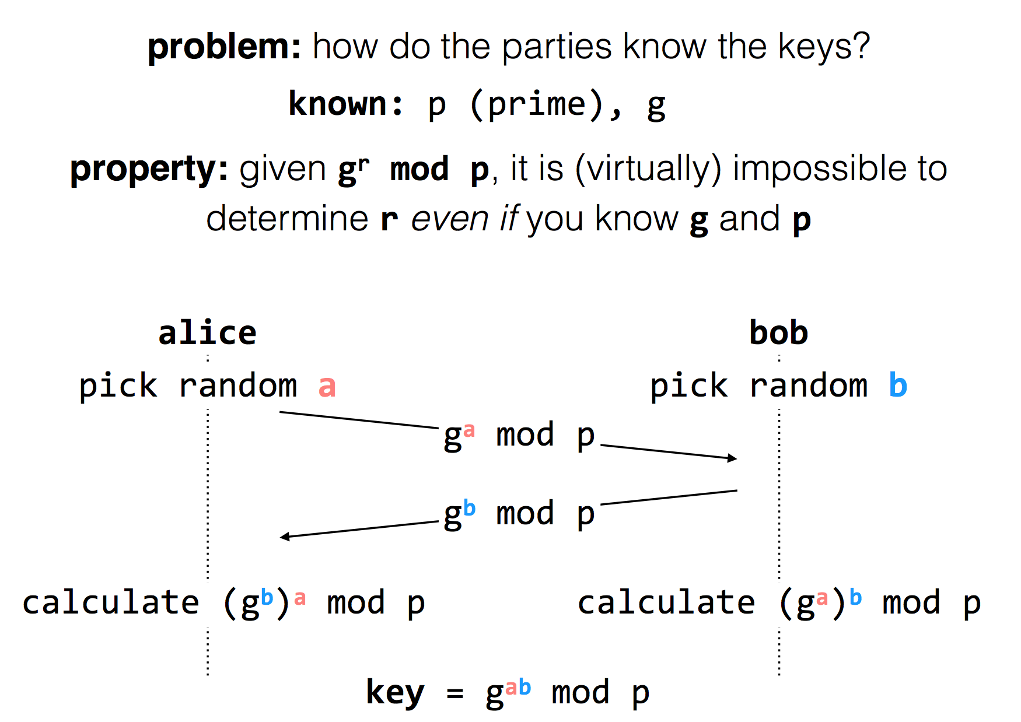
Diffie-Hellman
Key Exchange
(g^{b} mod p)ª mod p = g^{ab} mod p = (gª mod p)^{b} mod p
Notes:
g^i mod p ≠ g^j mod p （p为素数），其中i≠j且i, j介于1至(p-1)之间，则g为p的原根

Slide 78
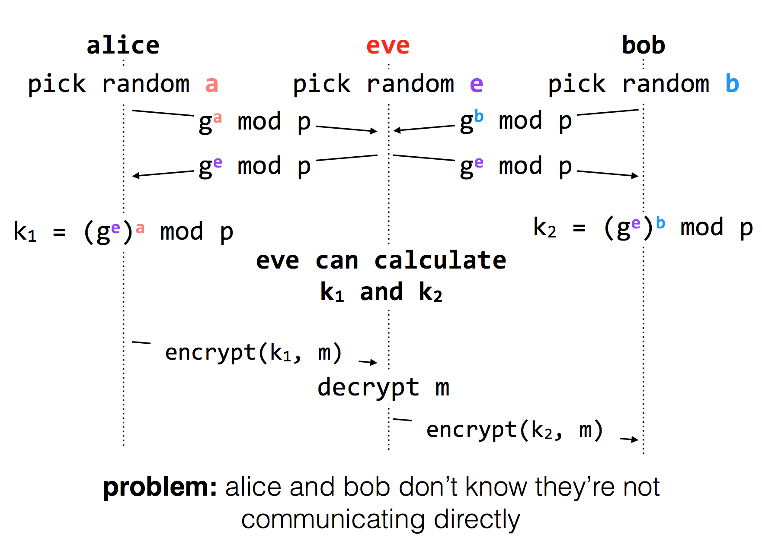
Diffie-Hellman Key Exchange & Man-in-the-Middle

Slide 79
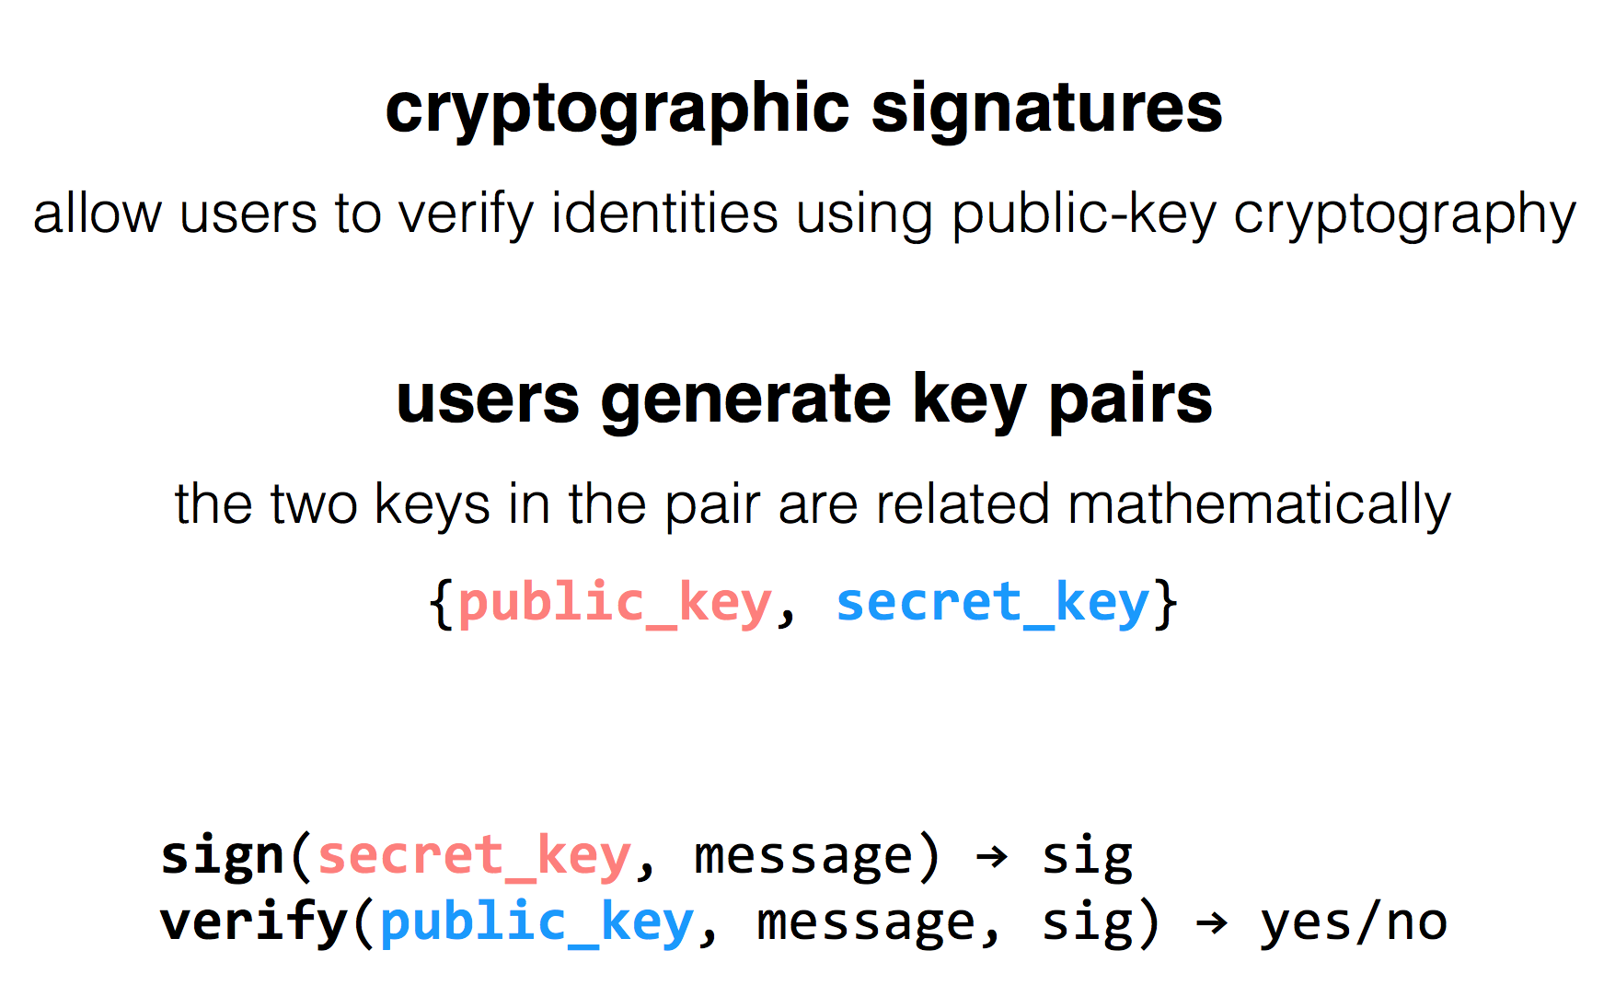
RSA Algorithm

Slide 80
Public Key Distribution
1. Alice remembers the key she used last time
Easy to implement
Effective against subsequent man-in-the-middle attacks
Doesn't protect against MITM attacks the first time around
Doesn't allow parties to change keys
2. Consult some authority that knows everyone's public key
Does not scale (client asks for a PK for every new name)
Alice needs server's public key beforehand

Slide 81
Public Key Distribution
3. Authority, but pre-compute responses
Authority creates signed messages: {Bob, PK_bob}_{SK_as}
Anyone can verify the authority signed this message, given PK_as
When Alice wants to talk to Bob, she needs a signed message from the authority, but it doesn't matter where this message comes from as long as the signature checks out
I.e., Alice could retrieve the message from a different server
This signed message is a certificate
More scalable

Slide 82
Review: Two Types of Encryption
Symmetric key encryption
Single key (symmetric) is shared between parties, kept secret from everyone else
Ciphertext = (M)^K
Asymmetric key encryption
Keys come in pairs, public and private
Secret: (M)^K-public
Authentic: (M)^K-private

Slide 83
Questions on Certificate Authorities
Who should run the certificate authority?
How does the browser get this list of CAs?
Generally they come with the browser
How does the CA build its table of names <-> public keys?
Have to agree on how to name principals, and
Need a mechanism to check that a key corresponds to a name
What if a CA makes a mistake?
Need a way to revoke certificates: Expiration date? Not useful for immediate problems
Publish certificate revocation list? Works in theory, not as well in practice
Query online server to check certificate freshness? Not a bad idea
Notes:
Alternative: avoid CAs by using public keys as names (protocols: SPKI/SDSI)
Works well for names that users do not have to remember/enter

Slide 84
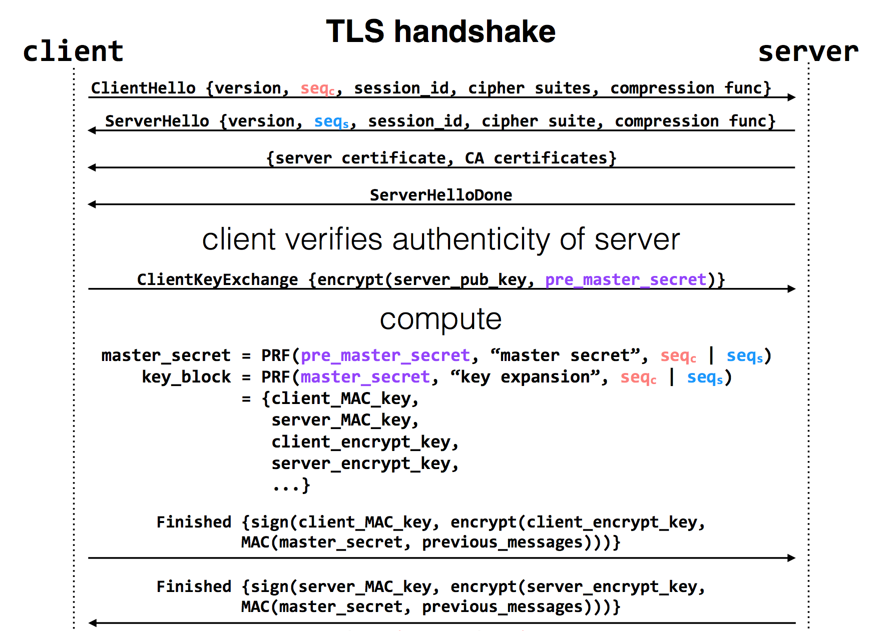
Notes:
pre-master-key is a random number
PRF: pseudo random function
Master key is a 48-byte sequence
https://crypto.stackexchange.com/questions/1139/what-is-the-purpose-of-four-different-secrets-shared-by-client-and-server-in-ssl

